Slide 1




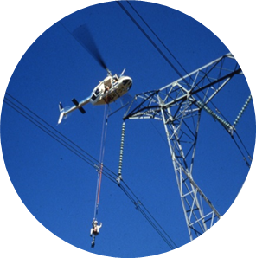

IEC 61850: Communication Protocols
Presented by: Teboho Richard Lekeno
Date: 09 February 2021

Slide 2
Purpose
IEC61850
Support communication to all functions done at substation
Allows exchange of information between IED’s
Protocols
MMS - Manufacturer Message Specification
GOOSE – Generic Object Oriented Substation Event
SMV – Sampled Measure Values

Slide 3
Purpose
MMS
Server/Client type communication
Used to exchange information between IED’s and SCADAs
The protocol is mapped on TCP/IP
Allows access to server for client to read/write data
Medium
1. Ethernet

Slide 4
Purpose
GOOSE
Publisher/Subscriber type communication
Communication is possible only inside the local network (LAN)
Used to exchange information between IED’s
It is an event based protocol
Publisher periodically sends messages & send burst messages when event occurs
Medium
1. Ethernet

Slide 5
Thank You

